Slide 1


End-to-End Data Engineering Pipeline

Slide 2

Project Overview
This project implements a complete, automated ELT data pipeline for NYC Green Taxi trip records.
Raw CSV files are ingested, stored, transformed, and modeled into a clean and performant star schema inside Snowflake.
The Challenge: Raw taxi data is messy, inconsistent, and inefficient to query manually.
The Solution: A fully automated system for Ingestion → Transformation → Testing → Analytics.

Slide 3







Key Use Cases
Ingestion
Transformation
Analytics
Orchestration
Automated loading of raw CSV files directly into Snowflake internal stages.
Cleaning and modeling raw data into a Star Schema using dbt.
Power BI connects to transformed tables for business intelligence.
Airflow schedules and manages the entire end-to-end workflow.

Slide 4
Technology Stack
Layer | Technology | Role
Orchestration | Apache Airflow | Schedules and triggers pipeline tasks
Data Warehouse | Snowflake | Scalable storage and compute engine
Transformation | Data Build Tool (dbt) | SQL-based data modeling and testing
Language | Python | Scripting and pipeline logic
Visualization | Power BI | Interactive dashboards and reporting

Slide 5




Pipeline Workflow
Extract
Load
Transform
Consumption
Raw CSV files are stored in a local directory (source).
Airflow uploads files to Snowflake Stage & Copy Into raw tables.
dbt cleans data, applies logic, and builds Fact/Dim tables.
Power BI connects to the Star Schema for analytics.

Slide 6
Star Schema Data Model
.
GEOGRAPHY('Locatio Dim’)
Specific Pickup and DropoffLocations.
DATE & TIME ('Date_Dim’)
This table acts as the project calendar. It enables trend analysis, allowing us to filter performance by Year, Month, Day, or specific Pickup and Dropoff timestamps.
CENTRAL FACT Table
Stores quantitative data for every trip. It houses key metrics like Fare, Tip, and Total Amount, enabling the calculation of revenue, averages, and financial performance.
TRIP DETAILS DIMENSIONS:
These dimensions describe trip characteristics. They track Vendors, Rate Codes, Payment Types (Cash vs. Credit), and Passenger Counts, allowing for detailed segmentation of specific ride behavior.
SURROUNDING DIMENSIONS :
Eight dimension tables surround the center to provide context. They are essential for filtering, grouping, and slicing the raw quantitative numbers into meaningful business insights.

Slide 7
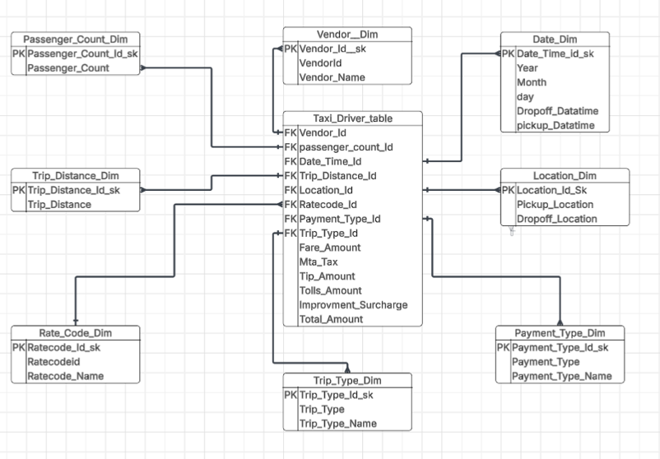
Design Star Schema

Slide 8






Data Warehousing with Snowflake
Internal Stage: @taxi_stage acts as the secure landing zone where Airflow pushes raw CSV files before loading.
Warehouse (Compute): TAXI_DRIVER_WH handles the heavy lifting for dbt transformations without impacting storage.
Database (Storage): TAXI_DRIVER_DB serves as the centralized repository for both raw staging tables and the final Star Schema.

Slide 9
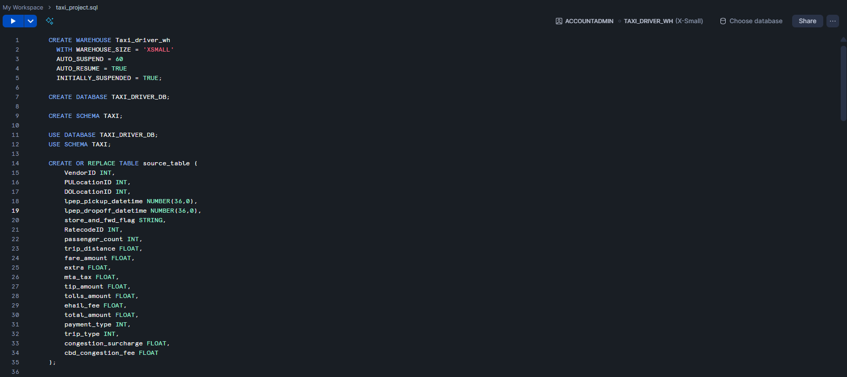
Snowflake Environment Setup

Slide 10
Data Build Tool (DBT)
The "T" in ELT
Executes transformations strictly after data is loaded into the warehouse, leveraging the compute power of modern platforms like Snowflake or BigQuery.
SQL-First Development
Allows analysts to write complex business logic using simple SELECT statements, while dbt handles the DDL (table/view creation) automatically.
Auto-Documentation
Automatically generates data lineage graphs and data dictionary documentation, ensuring transparency and trust in the data pipeline.

Slide 11
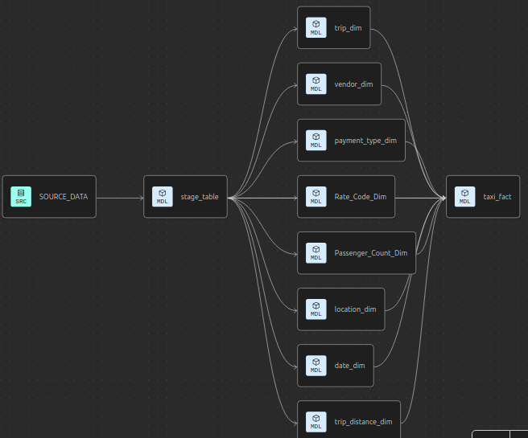
DBT Data lineage graph

Slide 12
Pipeline Orchestration
Centralized Control
Airflow acts as the heartbeat of the pipeline, orchestrating every step from raw data ingestion to final transformation
DAG Visualization The DAG (Directed Acyclic Graph) clearly visualizes dependencies. For instance, dbt_transformation is strictly dependent on the success of snowflake_stage.
Real-Time Monitoring The UI provides instant visibility into task success, failure logs, and execution duration, ensuring high reliability and rapid debugging.

Slide 13
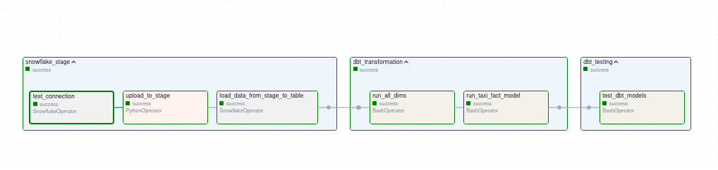
DAG Workflow Visualization

Slide 14
Analytics with Power BI
Direct Integration Power BI connects natively to Snowflake, leveraging the compute power of the data warehouse to query the transformed Star Schema in real-time.
Actionable Insights
Operations Dashboard: Monitor daily trip volume, peak hours, and driver performance.
Financial Overview: Analyze revenue trends, tip percentages, and payment type distribution.

Slide 15
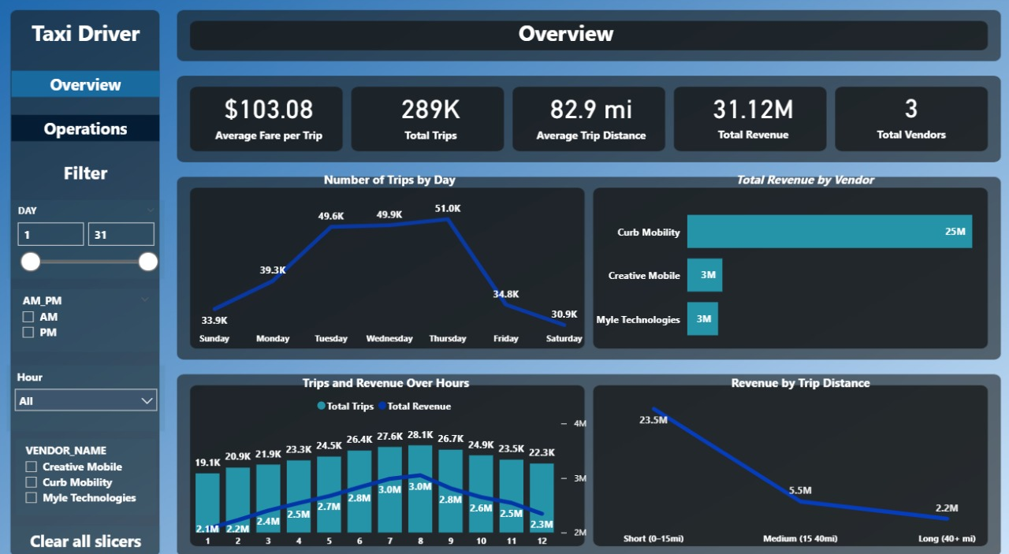
Overview

Slide 16
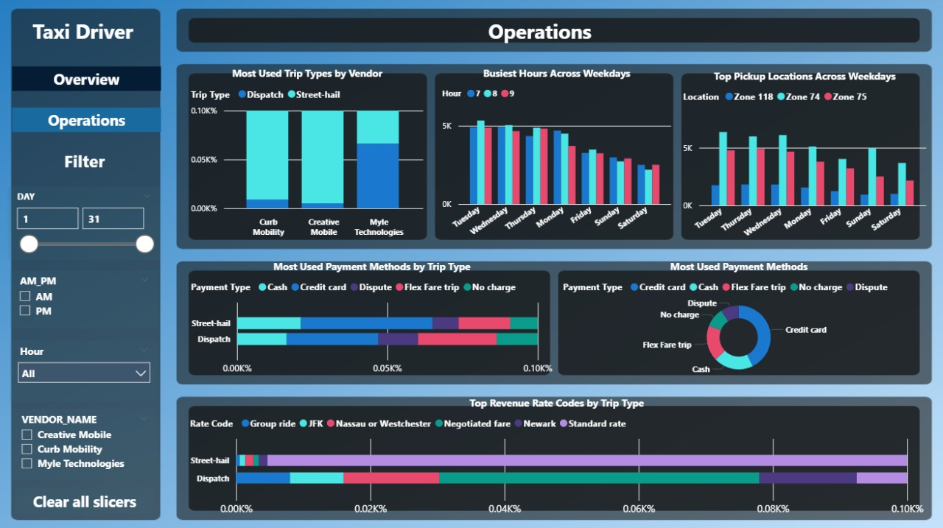
Operations

Slide 17
Q&A
Thank you!
amrkhaled123555@gmail.com
https://github.com/Amrkhaled74

